Slide 1
Unit 3
Extending Classes using Inheritance

Slide 2
Inheritance
The capability of a class to derive properties and characteristics from another class is called Inheritance.
Sub Class/Derived Class: The class that inherits properties from another class is called Sub class or Derived Class. Super Class/Base Class:The class whose properties are inherited by sub class is called Base Class or Super class.
Base Class
Derived Class

Slide 3
Need of Inheritance
Class Student
Class Employee
Name
Age
Address
DOB
getData()
putData()
Name
Age
Address
DOB
getData()
putData()
Duplication of Information

Slide 4
Class Person
Name
Age
Address
DOB
getData()
putData()
Super class/Base Class
Class Student
Roll no
Marks
Get()
Put()
Class Employee
Empid
Sal
Getibfo
Putinfo()
Subclass/Derived class

Slide 5
Implementing Inheritance
Creating Subclass:
class subclass_name : visibility mode base_class_name
{ //body of subclass };
Here, subclass_name is the name of the sub class, visibility_mode is the mode in which you want to inherit this sub class for example: public, private ,protected etc. and base_class_name is the name of the base class from which you want to inherit the sub class
E.g.
Class Student: public/private Person
{
----
};
Class Employee:public/private Person
{
-----
};

Slide 6
Class Person
{
string name;
public:
void get();
void put();
};
Class Student:public Person
{
int roll_no;
public:
Void getNo();
Void putNo();
};
Class Demo
{
Student s;
S.get();
S.getNo();
S.put();
S.putNo();
}

Slide 7
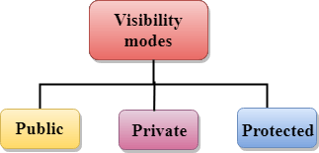

Slide 8
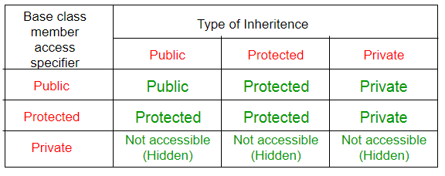
Sub calss Accessspecifier
Base class Member

Slide 9
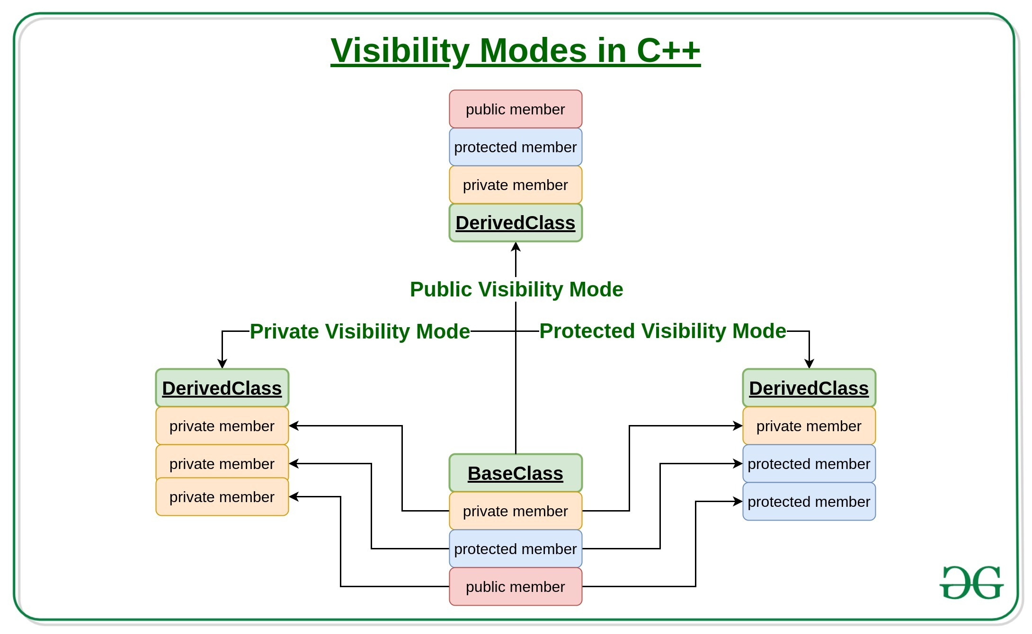

Slide 10
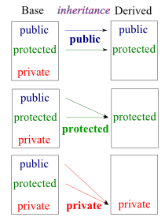

Slide 11
Modes of Inheritance
Public mode: If we derive a sub class from a public base class. Then the public member of the base class will become public in the derived class and protected members of the base class will become protected in derived class.
Protected mode: If we derive a sub class from a Protected base class. Then both public member and protected members of the base class will become protected in derived class.
Private mode: If we derive a sub class from a Private base class. Then both public member and protected members of the base class will become Private in derived class.

Slide 12
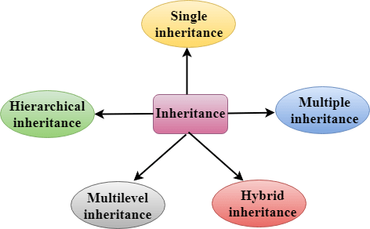
Types of Inheritance

Slide 13
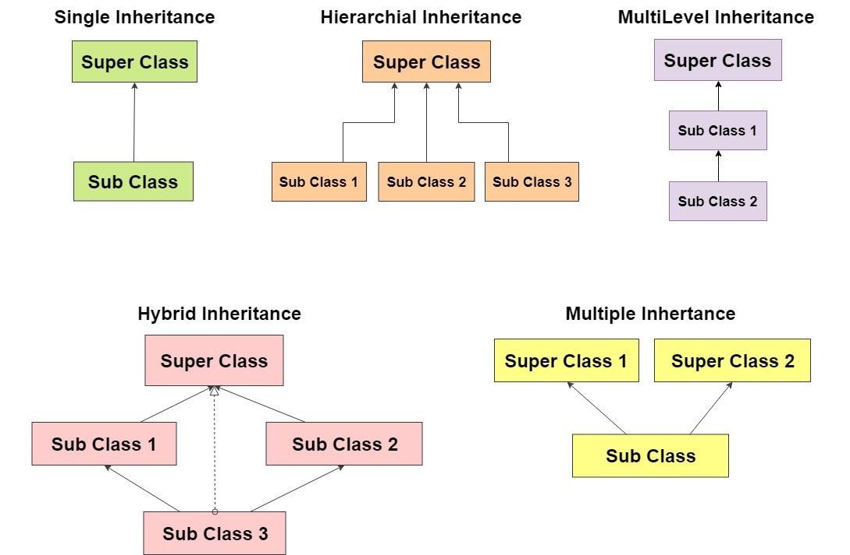

Slide 14
Protected Access Specifier
Protected: Protected access modifier is similar to that of private access modifiers, the difference is that the class member declared as Protected are inaccessible outside the class but they can be accessed by any subclass(derived class) of that class.

Slide 15
class MyClass { public: // Public access specifier int x; // Public attribute private: // Private access specifier int y; // Private attribute
protected:
int z;
};
Class subclass: public MyClass
{
public:
void set()
{
z = 22;
x = 20; //
Y =30;//
}
} int main() { MyClass myObj; myObj.x = 25; // Allowed (public) myObj.y = 50; // Not allowed (private)
myObj.z = 22; // Not Allowed (protected) return 0; }

Slide 16
Single Inheritance
In single inheritance, a class is allowed to inherit from only one class. i.e. one sub class is inherited by one base class only.
class Vehical
{
public:
void display()
{
cout << “In the Vehical Class”;
}
};
class Car: public Vehical
{
public :
void show()
{
cout << “In side Car Sub class”;
}
};
Vehical
Car
Void main()
{
Car ob;
ob.display();
ob.show();
}

Slide 17
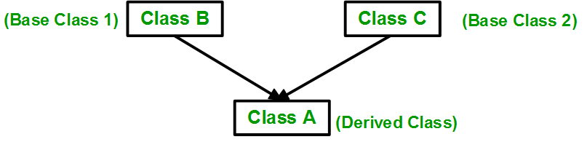
Multiple Inheritance
Multiple Inheritance is a feature of C++ where a class can inherit from more than one classes. i.e one sub class is inherited from more than one base classes.
Syntax:
class subclass_name : access_mode base_class1, access_mode base_class2, .... { //body of subclass };
e.g.
Class A: public B, public A
{
}

Slide 18
Multiple Inheritance
Vehicle
FourWheeler
Car
Class Car: public Vehicle, public FourWheeler
{
}

Slide 19
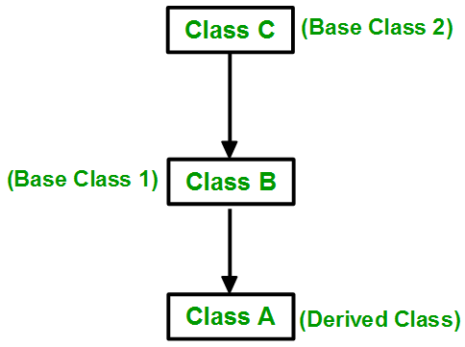
Multilevel Inheritance
In this type of inheritance, a derived class is created from another derived class.
Vehicle
FourWheeler
Intermediate Base Class
Car

Slide 20
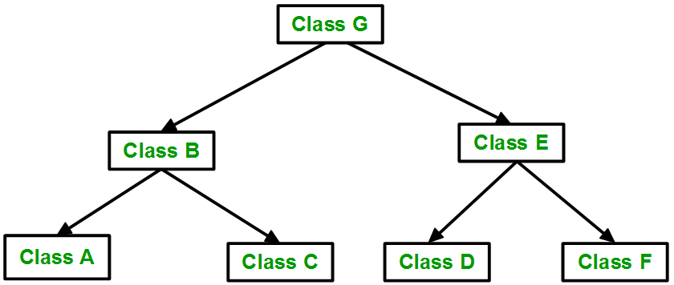
Hierarchical Inheritance
In this type of inheritance, more than one sub class is inherited from a single base class. i.e. more than one derived class is created from a single base class.
Vehicle
Car
Bus

Slide 21
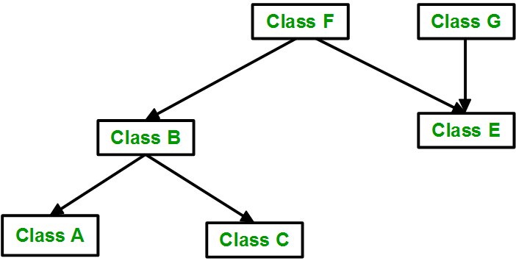
Hybrid Inheritance
Hybrid Inheritance is implemented by combining more than one type of inheritance. For example: Combining Hierarchical inheritance and Multiple Inheritance.
Vehicle
Fare
Car
Bus
Mini Bus

Slide 22
Special Case of Hybrid Inheritance
Class A
Int a
class ClassA {
public: int a;
};
class ClassB : public ClassA {
public: int b;
};
class ClassC : public ClassA {
public: int c;
};
class ClassD : public ClassB, public ClassC {
public: int d;
};
void main() {
ClassD obj;
obj.a = 10;
obj.a = 100;
}
Class B
Int b
Class C
Int c
Class D
Int d

Slide 23
Special Case of Hybrid Inheritance
In the above example, both ClassB & ClassC inherit ClassA, they both have single copy of ClassA. However ClassD inherit both ClassB & ClassC, therefore ClassD have two copies of ClassA, one from ClassB and another from ClassC.
If we need to access the data member a of ClassA through the object of ClassD, we must specify the path from which a will be accessed, whether it is from ClassB or ClassC, bco’z compiler can’t differentiate between two copies of ClassA in ClassD. There are 2 ways to avoid this ambiguity:
1. Use scope resolution operator
void main() {
ClassD obj;
obj.a = 10;
obj.a = 100;
obj.ClassB::a = 10;
obj.ClassC::a = 100;
}

Slide 24
Virtual Base Class
class ClassA {
public: int a;
};
class ClassB : virtual public ClassA {
public: int b;
};
class ClassC : virtual public ClassA {
public: int c;
};
class ClassD : public ClassB, public ClassC {
public: int d;
};
void main() {
ClassD obj;
obj.a = 10;
obj.a = 100;
obj.b = 20;
obj.c = 30;
obj.d = 40;
cout<< "\n A : "<< obj.a;
cout<< "\n B : "<< obj.b;
cout<< "\n C : "<< obj.c;
cout<< "\n D : "<< obj.d;
}
Syntax : Virtual Base Class
Class Deriverd class: virtual visibility mode Base class
{
Class Definition
}

Slide 25
Constructors in Derived classes
Whenever we create an object of a class, the default constructor of that class is invoked automatically to initialize the members of the class.
If we create a derived class derived class default constructor will be called.
Before that default constructors of the base classes will be called.

Slide 26
Constructor in Derived class
class Parent {
public:
Parent() {
cout << "Inside base class" << endl;
}
};
class Child : public Parent {
public:
Child() {
cout << "Inside sub class" << endl;
}
};
int main() {
Child obj;
return 0;
}

Slide 27
Order of Constructor call in Multiple Inheritance
For multiple inheritance order of constructor call is, the base class’s constructors are called in the order of inheritance and then the derived class’s constructor.
E.g.
Class A { A() { }… };
Class B { B () { }… };
Class C: public A, public B
{C() { }…};

Slide 28
class Parent1 {
public:
Parent1() {
cout << "Inside first base class" << endl;
}
};
class Parent2 {
public:
Parent2() {
cout << "Inside second base class" << endl;
}
};
class Child : public Parent1, public Parent2 {
public:
Child() {
cout << "Inside child class" << endl;
}
};
int main() {
Child obj1;
return 0;
}

Slide 29
Order of Constructor call in Multilevel Inheritance
Constructors are called in level of Inheritance
Class A {A() { …} …};
Class B: public A
{B() { …} …};
Class C:public B
{ C() {…} …};

Slide 30
Parameterized Constructors in Derived classes
To call the parameterised constructor of base class when derived class’s parameterised constructor is called, you have to explicitly specify the base class’s parameterised constructor in derived class.

Slide 31
class A{
Int a;
Public:
A(int i)
{ a = I ;
Cout << “ A “ << a;
}
};
class B:public A{
Int b;
Public:
B(int i,int j): A(i)
{ b = j ;
Cout << “ A “ << a;
}
};
Void main()
{
B ob(2,3);
}

Slide 32
class Parent {
public:
Parent(int i)
{ int x =i;
cout << "Inside base class's parameterised constructor" << endl;
}
};
class Child : public Parent {
public:
Child(int j): Parent(j)
{
cout << "Inside sub class's parameterised constructor" << endl;
}
};
int main() {
Child obj1(10);
return 0;
}

Slide 33
Whenever the derived class’s default constructor is called, the base class’s default constructor is called automatically.
To call the parameterised constructor of base class inside the parameterised consructor of sub class, we have to mention it explicitly.
The parameterised constructor of base class cannot be called in default constructor of sub class, it should be called in the parameterised constructor of sub class.

